Slide 1
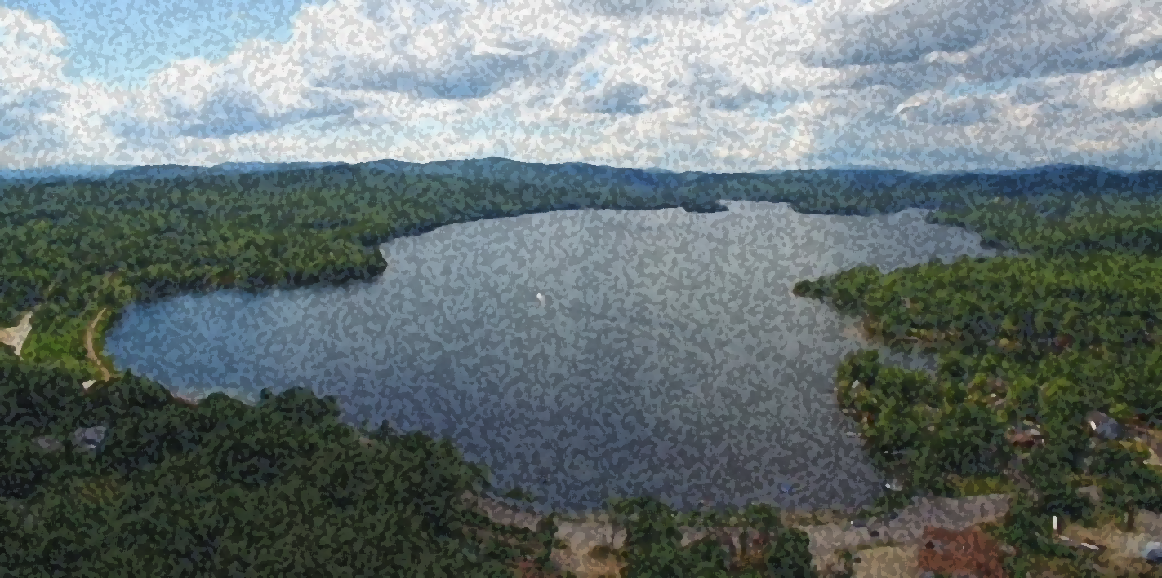
Windy Waters Conservancy
Windy Waters Conservancy
Annual Meeting
July 18th, 2024

Slide 2
Windy Waters Conservancy
Agenda:
Greetings
Pledge of Allegiance
President’s Report
Donna Van Ness Murphy
Election of Officers
Kiosk Refurbishment/Lake Hosting
Tim Whiting
Treasurer’s Report
Cindy Voltz
Lake Testing
Frank Murphy
Jamie Irving
Q&A

Slide 3
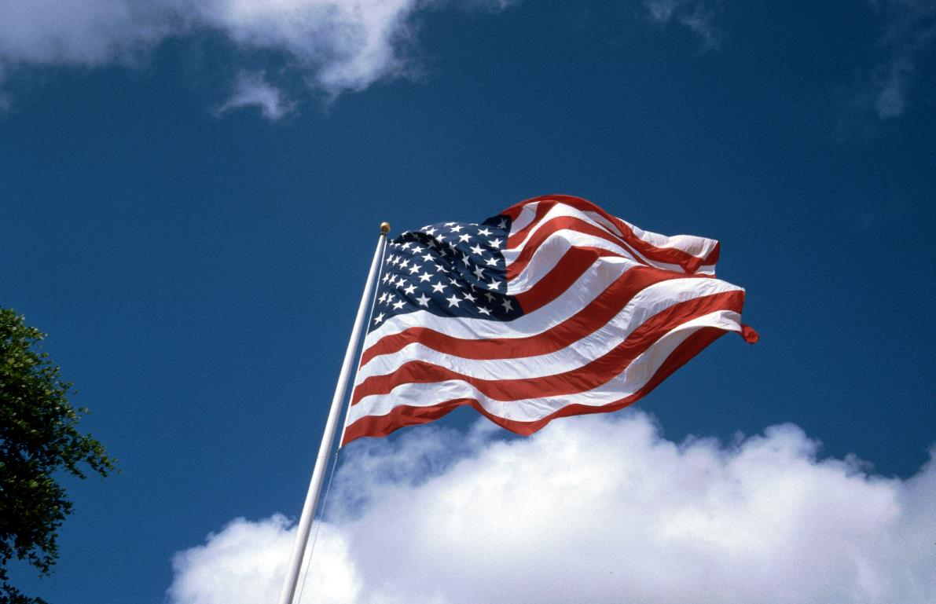
Windy Waters Conservancy
Pledge of Allegiance

Slide 4
Windy Waters Conservancy
President’s Report
Donna Van Ness Murphy
July 28th, 2024

Slide 5
Windy Waters Conservancy
President’s Report
Overview of grants:
200k grant clean water state revolving fund.
Included in this grant:
-Cyanobacteria monitoring including equipment (sonde, weather station, fluorometer)
-Biweekly water sampling (May-Nov)
Results report in early 2025

Slide 6
Windy Waters Conservancy
President’s Report
Overview of grants cont’d:
100K grant Warrant Article clean water state revolving fund
For update of Waukewan Watershed Management Plan
EPA-NHDES loan converts to grant
Any small amount of interest to be paid by WWC
7-18-24 -Waukewan awarded $100k grant to update Water Shed Mgt Plan

Slide 7
Windy Waters Conservancy
President’s Report
Cyanobacteria:
100k Mitigation Fund – Meredith
1 Mil Mitigation Fund –State
See something say something –DES protocol for blooms/Janan Hays 603-229-9562
Healthy Swimming Mapper
Google NHDES Healthy Swimming Mapper – will show updated watches and advisories for Cyanobacteria and Fecal Bacteria

Slide 8
Windy Waters Conservancy
President’s Report
Lake Kanasatka Cyanobacteria
Over 4yrs of work and over $825k to clean up the lake
Required a management plan, proof of shorefront mitigation and alumn treatment
WWC contributed $1,000 to Lake Kanasatka’s capital campaign

Slide 9
Windy Waters Conservancy
President’s Report
WWC Storm Water Runoff
Water Runoff into Lake Waukewan is one of the major contributors creating an environment for potential Cyanobacteria blooms
Your WWC offers a grant which supports half of your expenditures on solutions to prevent or curb water runoff up to $500.
For example: you spend $1000 on a project the WWC will pay $500, if you spend $100 on a project, WWC will pay $50

Slide 10
Windy Waters Conservancy
President’s Report
Waukewan Ramp Clean Up:
Last Sept was a great success
Filled a small DPW truck with tires, large pvc pipes, bottles, cans, etc
Sept 7th 2024 next ramp clean up, includes Water Dept cookout and tour
Waukewan Snail Hunts:
Last 6 yrs removed over 100k snails
First snail hunt this year netted fewer snails than previous years
Please scan your shoreline weekly

Slide 11
Windy Waters Conservancy
President’s Report
Waukewan Buoys:
Several buoys were missing and have just been replaced.
Pond Hockey on Waukewan:
There are some concerns about having pond hockey on Waukewan
Organization working with Advisory Committee/Water Dept to address these concerns

Slide 12
Windy Waters Conservancy
President’s Report
Loons on Waukewan:
There are 3 loon pairs on the lake
Two pairs have successfully hatched two chicks each
Please stay a distance away to minimize stress to the loon parents as they raise their chicks

Slide 13
Windy Waters Conservancy
President’s Report
Fireworks:
NALMS initiative to test waters after fireworks
300 volunteers across NH took water samples pre & post fireworks and 1 week post fireworks to test for any effects on the lakes
Thanks to Donna Van Ness Murphy and Frank Murphy for collecting and sending the samples from Waukewan

Slide 14
Windy Waters Conservancy
President’s Report
July 25th Outreach:
8 Lake Associations Involved, from 4 Meredith Lakes
Presenters: Ted Diers from NHDES, Bree Rossiter Conservation Program Mgr at Lake Winnepesaukee Assoc
Topics-Issues affecting lake quality, water quality monitoring, cyanobacteria, and restoration efforts
Invitation with RSVP sent out to the WWC membership

Slide 15
Windy Waters Conservancy
President’s Report
Meredith Canal Project:
Starts next spring
Projected to take several years to complete
Canal waters will be directed under ground and lake levels will be computer controlled
Meredith Capital Improvement:
Beautification for Main St moved forward to phase 2 - design

Slide 16
Windy Waters Conservancy
Election of Officers
Board of Directors
Welcome to Jim Wieler who volunteered to become a member of the board. Thanks Jim!

Slide 17
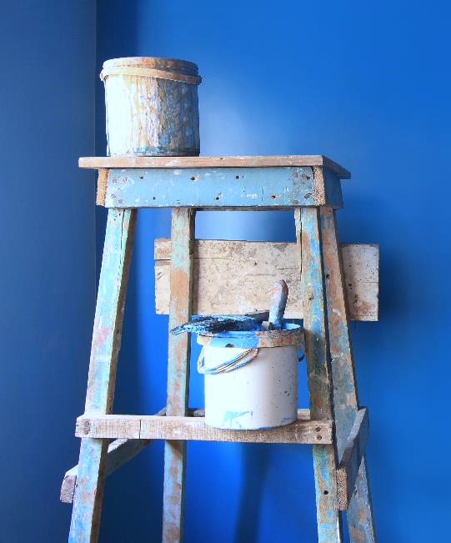
Windy Waters Conservancy
Kiosk Refurbishment
&
Lake Hosting
Tim Whiting

Slide 18
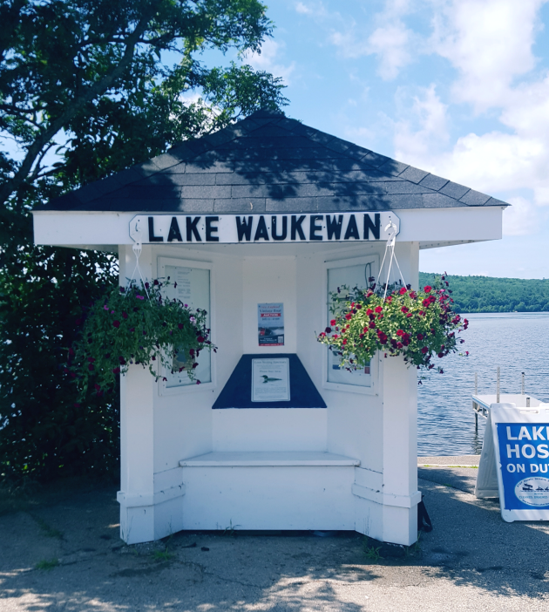
Windy Waters Conservancy
Kiosk Refurbishment

Slide 19
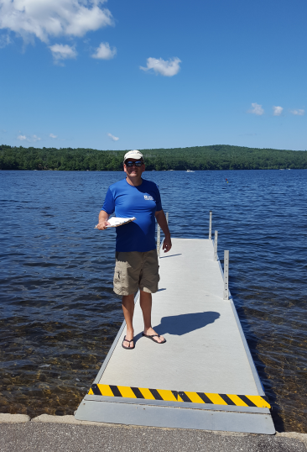
Windy Waters Conservancy
Lake Hosting
Thank You!

Slide 20
Windy Waters Conservancy
Treasurer’s Report
Cindy Voltz

Slide 21
Windy Waters Conservancy
How we apply your payments

Slide 22
Windy Waters Conservancy
Balances as of 7/18/2024
WSOA MVSB Balances
Operations $3,049.40 Conservation Account $2,663.22 Certificate of Deposit $36,045.17
Total Assets $41,757.79

Slide 23
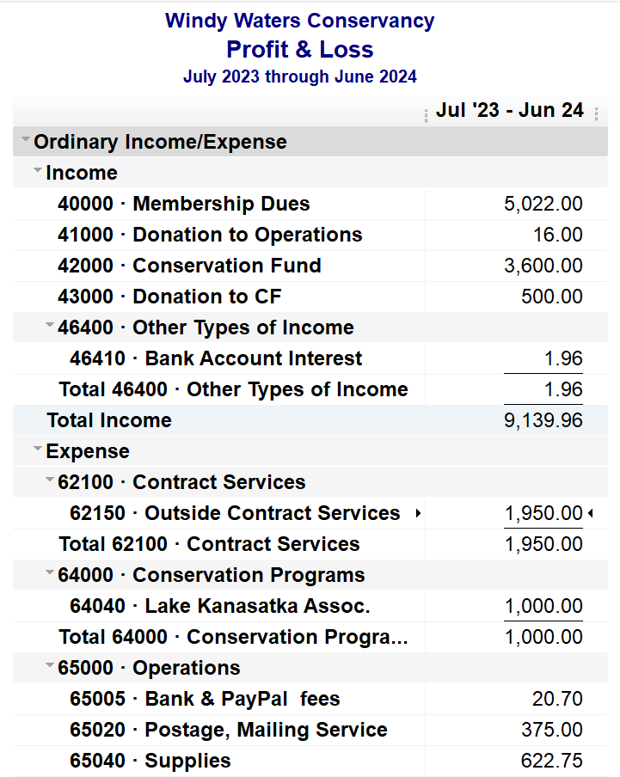
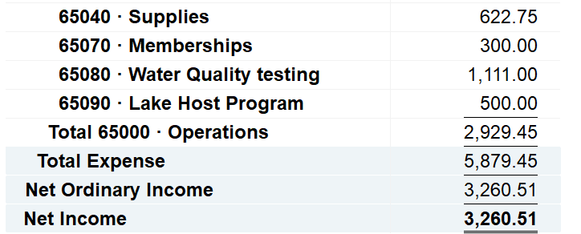
Windy Waters Conservancy

Slide 24
Windy Waters Conservancy
Lake Testing
Frank Murphy Jamie Irving

Slide 25
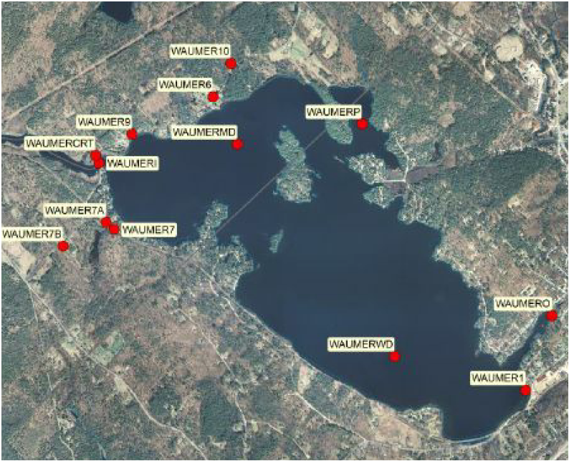
Windy Waters Conservancy
Volunteer Lake Assessment Program
What, When, Where ?

Slide 26
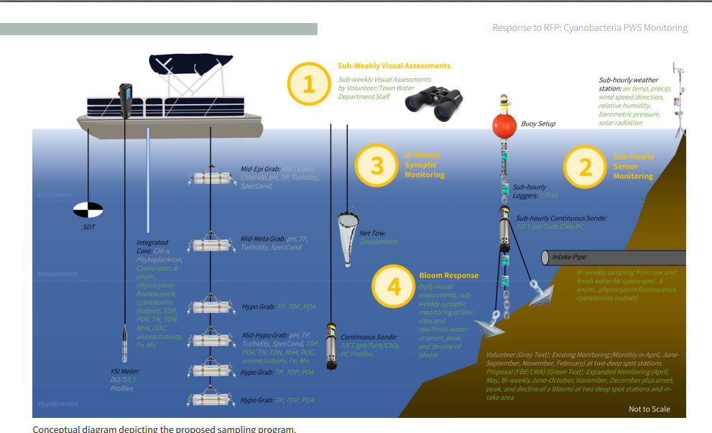
Windy Waters Conservancy
Volunteer Lake Assessment Program
Lake Testing

Slide 27
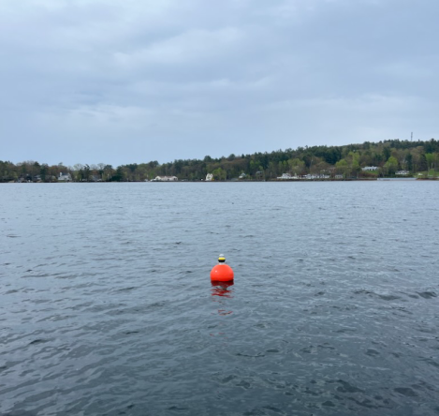
Windy Waters Conservancy
Volunteer Lake Assessment Program
Lake Testing

Slide 28
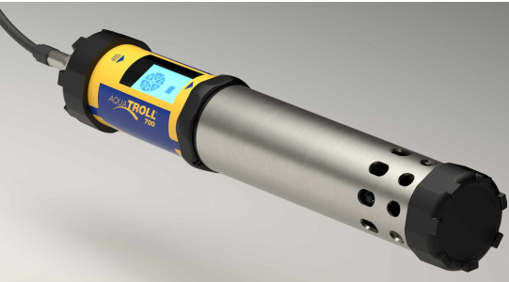
Windy Waters Conservancy
Volunteer Lake Assessment Program
Lake Testing

Slide 29
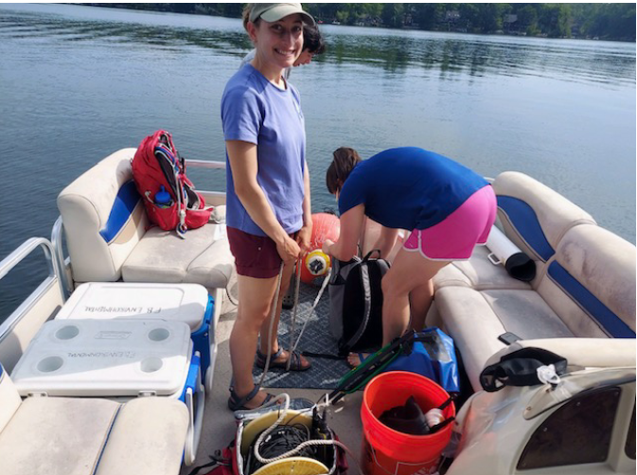
Windy Waters Conservancy
Volunteer Lake Assessment Program
Lake Testing

Slide 30
Windy Waters Conservancy
Volunteer Lake Assessment Program
•Oligotrophic
ol·i·go·tro·phic | \ ˈä-li-gō-
ˈtrō-fik, ˈō-; ə-ˈli-gə- \
Definition of oligotrophic
: having a deficiency of plant
nutrients that is usually
accompanied by an abundance of
dissolved oxygen
e.g.: clear oligotrophic lakes

Slide 31
Windy Waters Conservancy
Volunteer Lake Assessment Program
•Thanks to our sample takers:
•Frank Murphy
•Jamie Irving
John Slavik
John DeMichaelis

Slide 32
Windy Waters Conservancy
Open Discussion
•Member participation on the
Board of Directors
•Floor Motions
•Conservation Ideas
•What’s on your mind?
THANK YOU FOR YOUR SUPPORT!!

